Slide 1
Computer Assisted Segmentation of Iris Images for Bio metric Authentication
A biometric system provides automatic recognition of an individual based on some sort of unique feature or characteristic possessed by the individual.

Slide 2
INTRODUCTION
A biometric system provides automatic recognition
of an individual based on some sort of unique
feature or characteristic possessed by the individual.
Biometric systems have been developed based on
fingerprints, facial features, voice, hand geometry,
handwriting, the retina, and the one presented in this thesis, the iris.

Slide 3
OBJECTIVE
We will create an application which can add the
best possible layer of security to the system using
Bio metric authentication. Python will be used for
the development and concepts of
Machine Learning and Deep Learning will be used.

Slide 4
APPLICATION FEATURE
Localization
Segmentation
Normalization

Slide 5
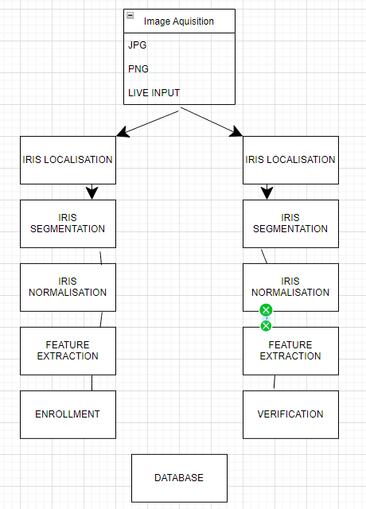
DESIGN DIAGRAM

Slide 6
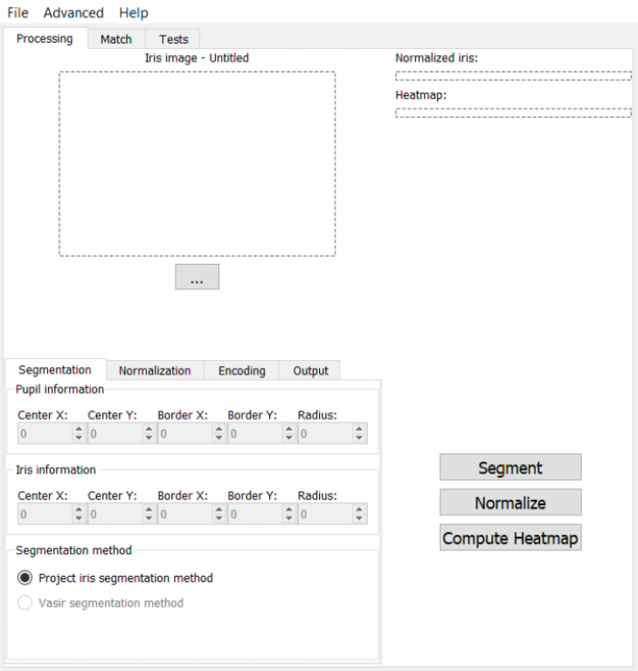
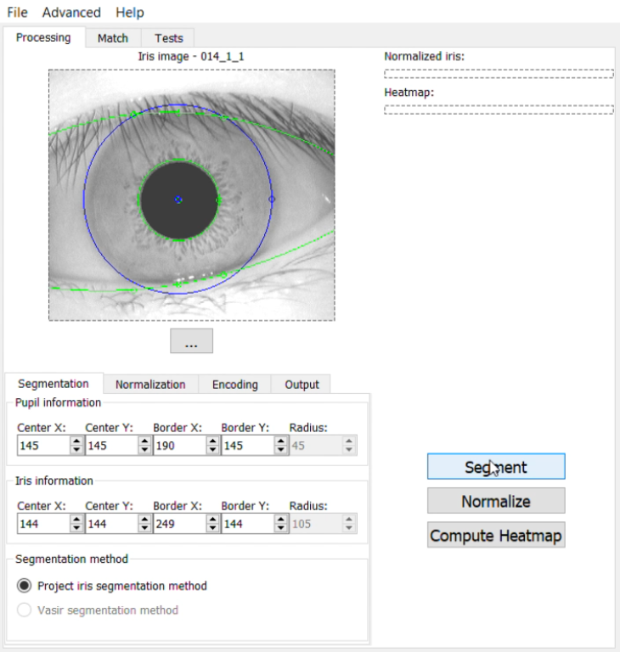
SCREENSHOTS

Slide 7
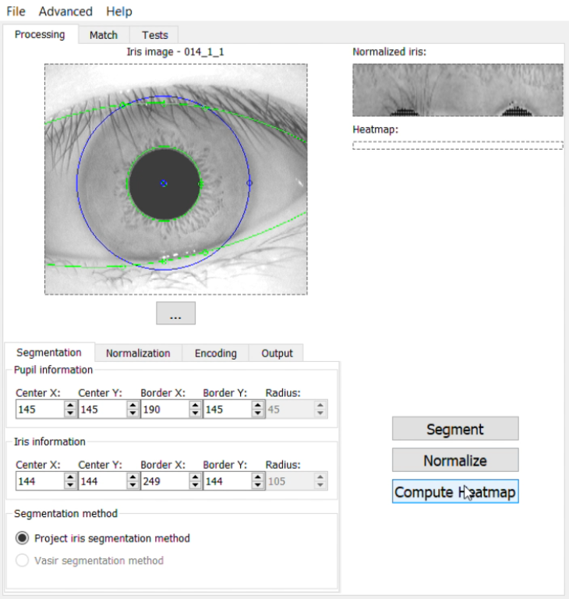
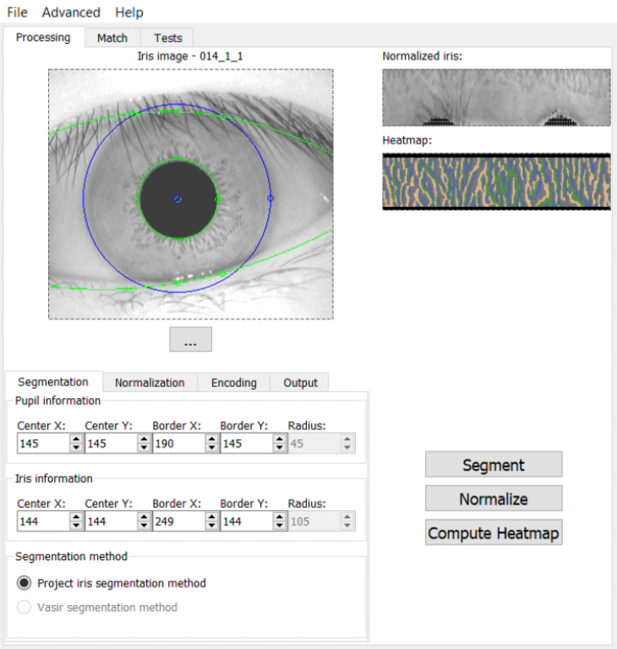
SCREENSHOTS

Slide 8
TECHNOLOGIES USED
Numpy
Opencv python
PyQt5
Utils
Normalization
Segmentation

Slide 9
OUTCOMES
Our application
Provides live iris recognition
Provides iris segmentation and normalization
Biometric identification

